Slide 1
Publishing Article Part 2

Slide 2
Methodology & Analysis
This is the most important section of the paper as the reviewer will look for the innovation in your method in this section.
Can be divided into several sub-sections
In another section, start with the general theory first then followed by your own formulations
Emphasis on the main innovation (never reported earlier) of the method. If your method partly utilize any known technique describe shortly with references.
Write down your algorithms (equations)/strategy and provide explanation on them
Describe your method in detail e.g., with equations, descriptions, block diagrams, flow charts, etc.
If applicable, provide an analysis of the method with a sample example to show its performance.

Slide 3
Methodology & Analysis
Explain the data used, their source, and any manipulations or adjustments of the data.
Explain and justify your analytical assumptions. Also explain models you may have used and be explicit about assumptions made.
Describe problems you may have encountered and how they were resolved.
Also, note unsuccessful approaches, techniques and procedures – this may help others to avoid problems or mistakes.
Be sure readers know how calculations were made and estimates derived.
Define all variables, including units of measurement. (These details are easily overlooked, but are important.)
Quantitative Analysis
Present numerical results: statistical data, power rating, power dissipation, …
Present tables: Run-time of your algorithm for several benchmark examples
Present graphs: Efficiency vs. Output power
Present improvement figures:
e.g. Our optimization algorithm resulted in a 20% reduction in chip area for the sp292 benchmark circuit …
Comparative Analysis
Comparing two different approaches to the same problem
Tabulate results for two different heuristics
Comparing the performance for two different parameters
Tabulate results for two different technologies/ voltage values/ …

Slide 4
Simulation Study
Once the methodology and its analysis are done, provide the simulation results in this section.
Regarding simulation method and software, indicate in brief, especially when you have experimental results. There might be some exception depending on the type of the work.
Provide a write-up on how the simulation is carried up (including all assumptions used, how important parameters are chosen/selected, etc.)
The results should be presented along with discussion. Particularly, indicate the significance of the results in terms of your methodology.
Reviewer gets annoyed with the meaningless results. Try to avoid that.

Slide 5
Hardware/Software Development
As a result of your proposed algorithm, you might have developed a software to test its viability through simulation
Provide a description of how the software is developed (Computer specs, Programming Languages used, Flowcharts, Block diagrams, etc.)
Sometimes hardware are designed to verify the proposed technique/algorithm
Provide sufficient description of the hardware setup/design (technical specifications, block diagrams, saturations, sensor limitations, components used, photos of the hardware, etc.)
Highlight the uniqueness of your hardware compared to similar products (if any)

Slide 6
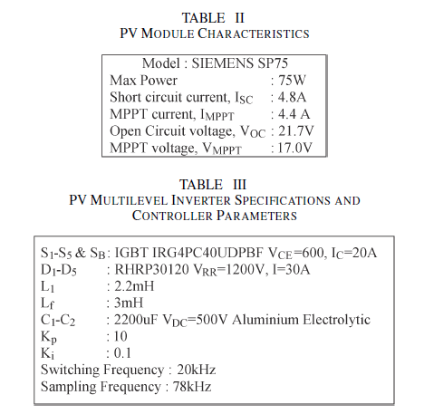
Experimental
Describe your experiments in detail such that others can replicate your work
Describe Apparatus and Materials
Show test setups
Provide the detail experimental implemental procedure, if it is new. Even if it is not new, still provide the procedure in brief.
Meaningful experimental results will be provided with discussion. If possible, in order to show the superiority of the proposed method provide comparative experimental and/or simulation results with the published method.
Based on the results provide a summary about the performance of the proposed method.
Reduce detailed description of the experimental method in the paper if the experimental and computational techniques have been previously verified in textbooks, reference books, and other refereed publications.
Specify the operational conditions and any unique aspects of the research methods used.

Slide 7
Results & Discussion
Results and Discussion: enumerate your results and discuss upon them
Provide details on performance
Comparisons
If they are good the reader should get the message without you having to explicitly write it
Results can be tabulated in several forms (use graphical form where applicable)
Usually comparisons with existing techniques (conventional or otherwise) are required to show the effectiveness of the proposed technique.
Provide merit discussions – correct analyses of your experimental results show the quality of the paper. Always provide answers to why the experiments went such a way.
Consider moving large quantities of raw data, detailed derivations, or code to an appendix
Results should be critically compared to theory
Do not repeat results presented in graphs/figures in the text

Slide 8
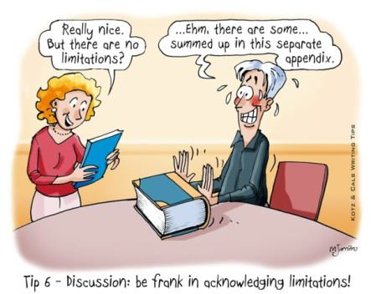
Discussion ...
Consider limitations in the theory and engineering tolerances
What conclusion can you draw from your experiments?

Slide 9
Conclusions
Highlight the major advantages of the technique/method proposed when compared with other techniques or conventional techniques
Do not repeat text from abstract and introduction
Which new research directions are set by the paper?
Write suggestions to improve the problems or limitations of the proposed technique (such as in future work)
Final sentence should be the recommendation and/or overall evaluation of the proposed method.

Slide 10
Acknowledgements, Appendix & References
Acknowledgements:
People that gave some specific help (but not at the level of becoming an author)
Include: your sponsor, funding sources (companies or agencies), other departments on campus, individuals outside of your team who have helped
Be brief
References:
There could be 15-30 references with research paper. There could be less references if it is purely innovative work.
Avoid the internet link in the reference as it is not an archival material.
contains only the papers cited in your work
use the best and most up to date literature (at least 5 years back)
make sure its relevant
avoid self-glorification
must be correct and complete citation information
can they find it from your information?
prefer archival works to hard-to-get technical reports/obscure publications
should conform to style of publication
most publications are strict about this
Appendices:
These can be very useful, but are not always used.
They can be used to present material that might disrupt the flow of thoughts in the report (e.g. too much detail) or include information of interest to only some readers.
E.g. Mathematical proofs or derivations , some statistical estimations or tests

Slide 11
Authorship
Authorship criteria varies with institutions and publishers
e.g. IEEE recommendation:
Authorship credit must be reserved for those who met each of the following conditions:
Made a significant intellectual contribution to the theoretical developments, system or experimental design, prototype development, and/or the analysis and interpretations of data associated with the work contained in the manuscript;
Contributed to drafting the article or reviewing and/or revising it for intellectual content;
Approved the final version of the manuscript, including references.

Slide 12
Strategies in Writing Good Technical Papers
Identify the novelty of your research work
This can be done from the literature review, by comparing your research results with others
Identify and highlight the problems and limitations of current techniques already proposed by others
Write down how your research (proposed technique) can overcome the above limitations or problems
Provide a good analysis on the research results
Do not just write down what has been observed from your experiments
Explain why these observations are ‘so and so’
Provide a summary of results and how results led to conclusion

Slide 13
Strategies in Writing Good Technical Papers
List down the strengths and weaknesses of your proposed technique
If your proposed technique can only be applied to a certain class of problems, then try to be ‘creative’ and write to focus only towards these problems
Do not allow reviewers to attack your weaknesses, it would be good to mention the weaknesses of your proposed technique in the paper, again try to be ‘creative’ in writing such as “this is to demonstrate on certain applications…”

Slide 14
Paper Submission
Competition for space in journals is intense
The cost of publication is high
Rejection rates vary 50-90%
Author Publishing Priorities
Quality and speed
Top items were
Refereeing speed
Refereeing standard
Journal reputation

Slide 15
Major Reasons for Rejections
Confirmatory (not new or innovative)
Overwhelming submissions
Poor design
Poorly written
Inadequate identification of a research problem
Inappropriate or unclear methods and procedures
Inappropriate material for the proposed publication
Failure to communicate what is important and original
Poor organization.

Slide 16


Slide 17
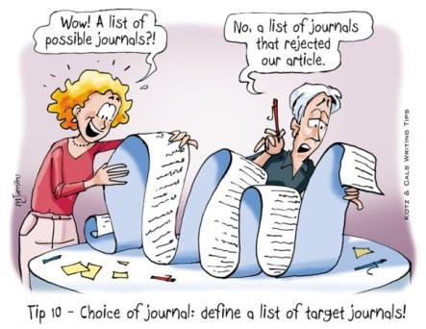
Journal Selection
How long is publication cycle?
See publishers’ publication history
Get experiences by publishing in diverse group journals
Is your paper within the scope of journal or not?
Journal impact factor
This reflects the quality of the journal

Slide 18
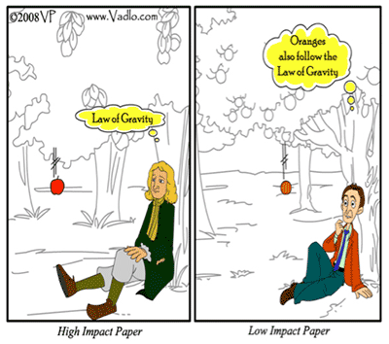
Journal Selection
Choose the most appropriate journals with the highest “impact” (average citations per paper), prestige, and the largest circulation. Cost-free color publication is a consideration.
How the paper is written depends on the journal, the intended audiences, and the goal of your presentation.
Are you aiming at specialists or the more general scientific community?

Slide 19
Impact Factor
A journal’s impact factor (IF) is an annual measure of the extent to which articles in that journal are cited.
It’s a rating that’s calculated by the Institute for Scientific Information and published in an annual volume of the Science Citation Index or on their website.
It can be used – with caution – as a rough measure of the reputation of a journal. The rationale behind the system is that the higher the impact factor, the more important the journal.
But the ratings are not entirely accurate. For example, review articles get cited a lot, and so a journal that publishes a lot of review articles will have a very high impact factor.

Slide 20
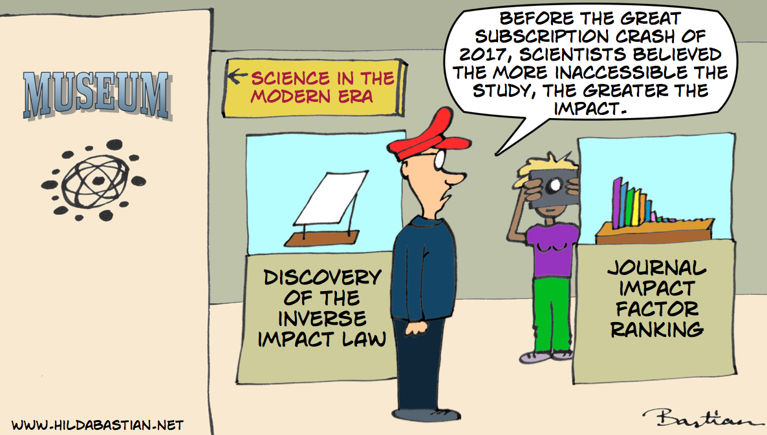

Slide 21
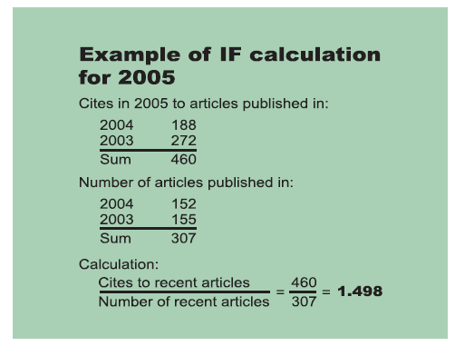
IF Calculation
Source: Diana Epstein, The Journal of the European Medical Writers Association, Vol. 16, No. 3, 2007

Slide 22
Journal Classification
ISI (Q1, Q2, Q3, Q4, Non-tier) (http://webofknowledge.com)
SCOPUS (www.scopus.com)
Open Access (http://www.doaj.org/)
NON-SCOPUS/NON-ISI
Regional
International
Local

Slide 23
Open Access Journal
‘Open Access’ (OA) journals are scholarly journals that are available without financial or technical barriers other than Internet access
Articles either are directly accessible from the publisher or archived in a repository
In most cases, the copyright is owned by the author, not the publisher
Some OA journals are subsidized by academic or governmental institutions
Link: http://www.doaj.org/

Slide 24
OA Journal Options
‘Fee-based OA journals’ require payment by the author - often paid by a grant or institution; access is free to all users
these OA journals accept articles from authors; the number varies from journal to journal; peer-reviewers (theoretically) do not know if authors have requested fee waivers
‘Delayed open access journals’ where the articles are available between 6 – 24 months
‘Hybrid open access journals’ contain some current articles that are free access

Slide 25
Before Submission
Select your journal carefully
Read the aims and scope
Think about your target audience and the level of your work – do you have a realistic chance of being accepted?
Follow the guidelines in the notes for authors and include everything they ask – it makes the editor’s job easier…
Some journals provide forms:
Disclosure of Conflict of Interest
Acknowledgment of funding sources
Image manipulation guidelines
Online submission - supplemental information (datasets, videos)
Your paper should not be submitted to more than one journal at a time
For some IEEE Transactions, the same paper should not be published anywhere if it is submitted for review to that Transactions. It is a great offence to publish the same paper in two different journals and you could be banned to publish papers in IEEE for whole life.
However, for IEEE Transactions on Industry Applications there is a restriction that the paper first needs to be presented in IEEE Industry Applications Society (IAS) sponsored conferences if you want to submit the paper for review for transactions.

Slide 26
Before Submission
Almost all journals provide a format or template before papers can be published
References are always required to be written in a certain format
If the paper format is not specified by the journal, write the manuscript into single column, double spacing with font size 12.
Reviewing duration depends on the publisher and the reviewers
Some journals require the submission of the title, abstract, authors and keywords on a web page, and the main text, every figure and every table are submitted as separate files.
Once all sections have been validated (i.e. the picture files are numbered correctly and all have been checked for clarity and the captions have been added on-line), the paper is assembled as a single *.pdf file.
This file must be reviewed and checked by the authors before final submission to the editorial board is possible (all of these processes and checks are automated in on-line paper submissions).

Slide 27
Before Submission
Traditional submission (by mail)
Online submission
As one or more e-mail attachments
Via a journal web site
Inclusion of a cover letter (conventional or electronic)
Completion of required forms—for example, declaration, copyright
Many publishers now offer a completely electronic submission process
Article is submitted online and all of the review procedure also happens online
Speeds up the editorial process
Is invaluable for authors in low-income countries
Some online paper submission link:
IEEE Access: http://ieeeaccess.ieee.org/submitting-an-article/
AIAA: https://mc.manuscriptcentral.com/aiaa
AIP: https://publishing.aip.org/authors/submit-peer-xpress

Slide 28

Cover Letter
Title and author(s) of paper
Journal name
Type of submission (Full length article/technical note)
State that your paper is new and not being submitted elsewhere
Keywords
Sometimes:
Why the paper is important
Some possible peer reviewers (Some journal request that)

Slide 29
After Submission
Most journal editors will make an initial decision on a paper - to review or to reject
For appropriateness of subject matter
For compliance with instructions
For overall quality (sometimes)
The Editor-in-Chief of the journal will allocate an Associate Editor, who will appoint two or more reviewers based on their expertise.
Some journals require the authors of the paper to suggest the names and contact details of suitably qualified people who can be approached to review the paper.

Slide 30
Review process
Once the reviewers have accepted their nomination, the file is sent to the reviewers for consideration.
Some publishers practice a ‘blind’ review process: the names and affiliations of the authors are not included in the file sent to the reviewers.
The aim of this process is to reduce bias on the reviewers.
Evaluation by experts in the field
Purposes:
To help the editor decide whether to publish the paper.
To help the authors improve the paper, whether or not the journal accepts it.
Some ways peer reviewers are identified:
references, literature searching, editors’ knowledge, databases, authors’ suggestions

Slide 31
Review process
The reviewers are required to comment on both the technical content and the quality of the language used, and will submit one of the following recommendations:
Accept (no changes required);
Accept (minor editorial changes required);
Accept (major changes required); or
Reject (usually because there is no major scientific or engineering advance reported, or parts of the paper have been previously published, or parts of the paper have been directly copied, or the paper is technically incorrect).
It may take from 1 week to 3 years
One to 6 reviewers along with editorial comments
Some journals editors assess submission and provide decisions if no new contributions

Slide 32
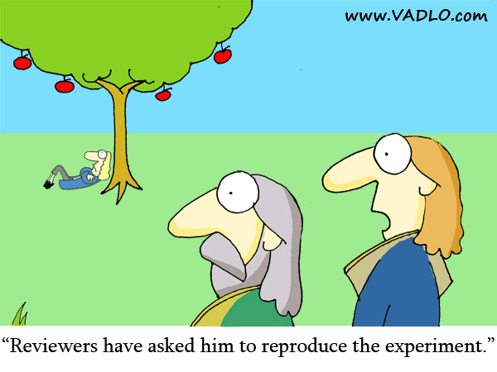

Slide 33
Review …
Reviewers make comments and recommendations on the following topics:
Abstract: Does the abstract sum up the major findings clearly and succinctly?
Novelty: Does the paper present new knowledge which is important to the engineering/science discipline?
Literature review: Does the paper adequately refer to the most important published literature – both historical and recently published articles?
Experimental methods: Is the experimental method appropriate and is the method capable of yielding the correct results to the accuracy required?
Results and analysis: Is the method of analysis appropriate and statistically valid? Have the results been independently verified through a comparison with the work of others or through other methods – theory, computational modelling, etc.?

Slide 34
Review …
Discussion and conclusion: Do the conclusions logically follow from the research results? Have the authors reviewed their methods and commented on the strengths and weaknesses of their experimental method? Have the authors commented on the next logical steps of this research? Have the authors commented on the impact of this work on the engineering discipline?
Quality of writing: Is the language clear and concise? Any contradictory statement? All typographical errors must be noted and referred back to the authors.
Quality of the figures: Are the figures sufficiently clear? Are the axes on the plots labelled correctly together with units? Are the captions self-contained?

Slide 35
Typical Questions from Referee
How does it relate to existing work?
bibliographies, background, important omissions...
What is new and significant in the work reported?
New?
has it been done before?
is it a rehash / republication of old stuff (yours or others)?
How reliable are the methods used?
are they adequate to support the conclusions
is it correct?
are there any errors (math, loopholes...)
How reasonable are the interpretations?
good arguments
alternative interpretations explored/left out
Can an experienced practitioner in the field duplicate the results from the paper and the references?
unethical to publish something that can’t be reproduced

Slide 36
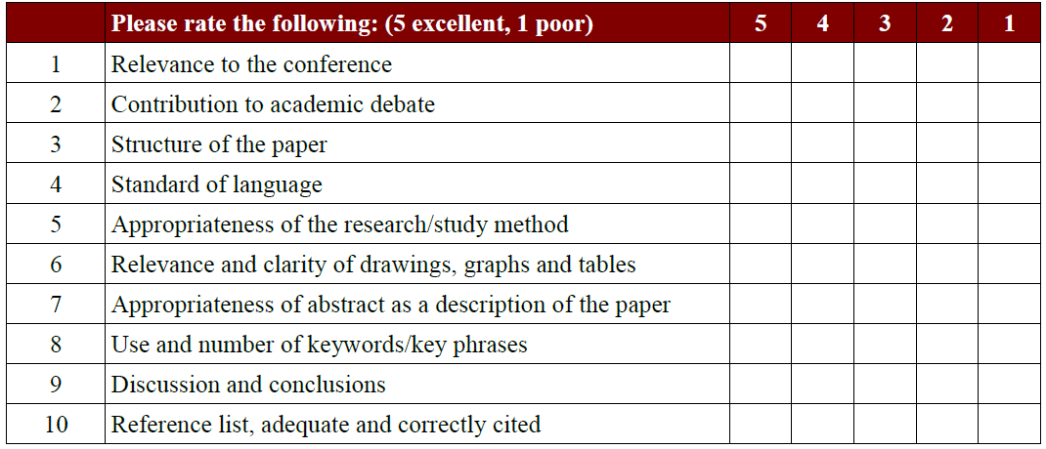
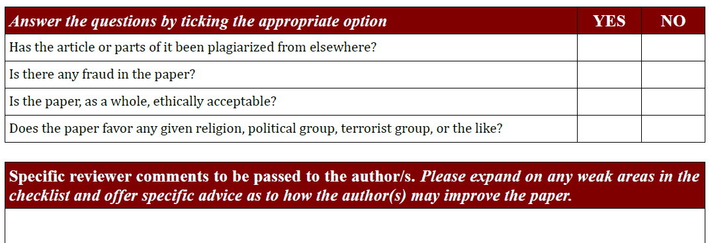
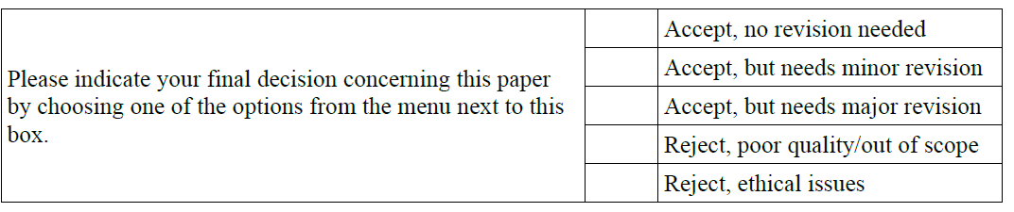
Typical Questions from Referee

Slide 37
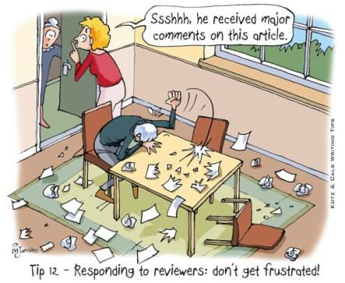
Responding to Reviewers
When a paper has been submitted for publication in a journal, and the authors receive the feedback from the Associate Editor as ‘minor changes’ or ‘major changes’, they must make corrections to the original submission in a fixed time allotted by the journal editorial committee.
Do the corrections according to the comments and sometimes you can’t do something, explain, why.
Always try to avoid any conflict with the reviewer.

Slide 38
Responding to Reviewers
Carefully prepare your responses
Each comment should be addressed (a point-by-point response )
Each change should be stated
Be enthusiastic
Respect any comment from the reviewer even if the reviewer may be wrong
Be tactful – thank the reviewers
Do not respond to reviewers while upset
Commonly the paper will be resubmitted to the journal and sent out for review to the previous reviewers.
In order to make the second review relatively simple for the reviewers, the authors must submit two documents:
The revised paper with the important changes highlighted; and
A list of all of the reviewers' comments and the author's response to those comments.
Include a letter saying what revisions were made. If you received a list of requested revisions, address each in the letter.
If you disagree with a requested revision, explain why in your letter. Try to find a different way to solve the problem the editor or reviewer identified.
If any point raised by referee is not clear, please communicate with referee through Editor
If the paper get rejected don’t throw it out. Read the reviewers and associate editor’s comments, you might get some new idea or the same paper could be little bit modified based on the comments and then resubmit the modified paper for the same journal or different journals.

Slide 39
Epilogue
The goal of writing paper is not merely to publish, but to publicize your work.
Use an intriguing title
Use attractive illustrations, visual materials. Write well
The best guide to writing papers and abstracts is to read the published work in the field, and the specific journal in which the paper is to be submitted.
Do not submit a paper without sufficient contents.
Focus on one particular subject area, for publishing one paper. Including more ideas may produce one that says many things, but nothing in depth
Journal paper should have something new. If the work produces no new contribution, it should not be sent for a journal publication.
Originality of the work must have to be maintained.
Never submit a paper to more than one journal, at a time.
If one paper is accepted for publication to one journal, it should not be sent for publication to another journal.
Publish the paper to an appropriate journal, relevance has to be maintained.

